Slide 1



Introduction to DEEP
LEARNING
Deep Learning
Course
14 Slide

Slide 2



PRESENTATION
Content List
₀₁ Convolutional Layers
₀₂ Pooling Layer
₀₃ Flatten Layer
04 Fully Connected (FC)
05

Slide 3

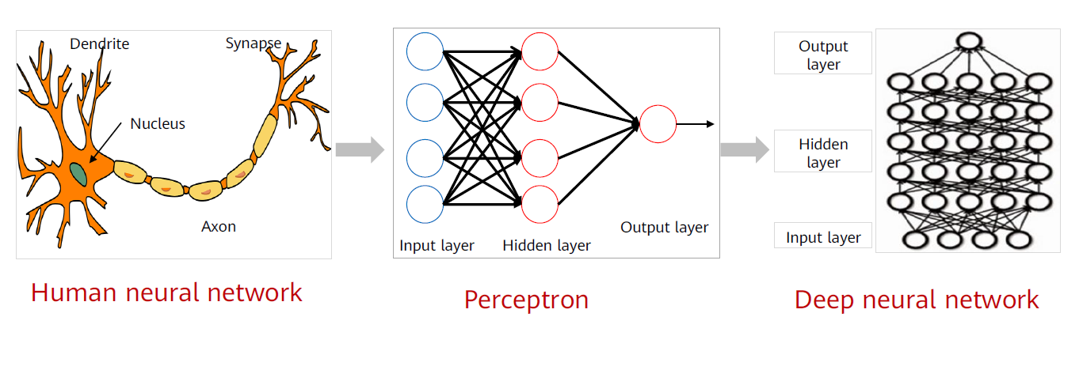
01
DEEP LEARNING
Generally, the deep learning architecture is a deep neural network. "Deep" in "deep learning" refers to the number of layers of the neural network.

Slide 4
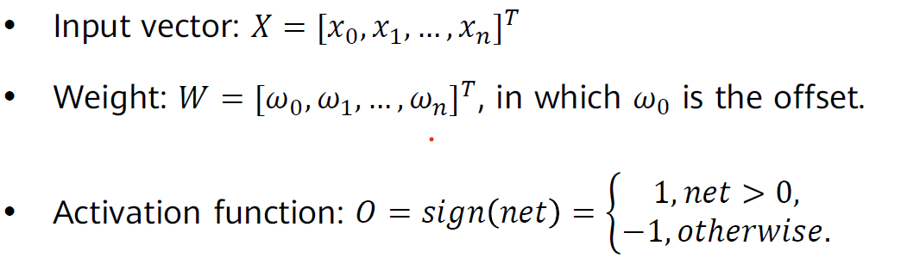
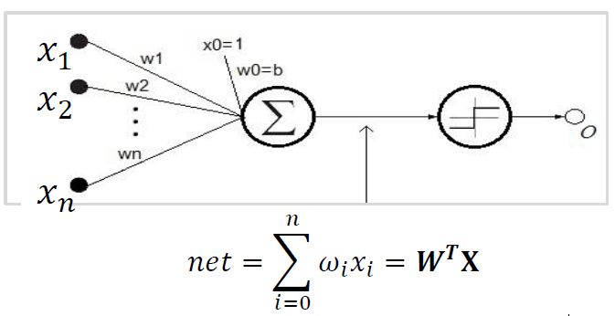
02
Single-Layer Perceptron

Slide 5
02
Single-Layer Perceptron
does Neural Network Can Do what ML Do?
Linear Regression using ML experiment
Linear Regression using SLP experiment

Slide 6
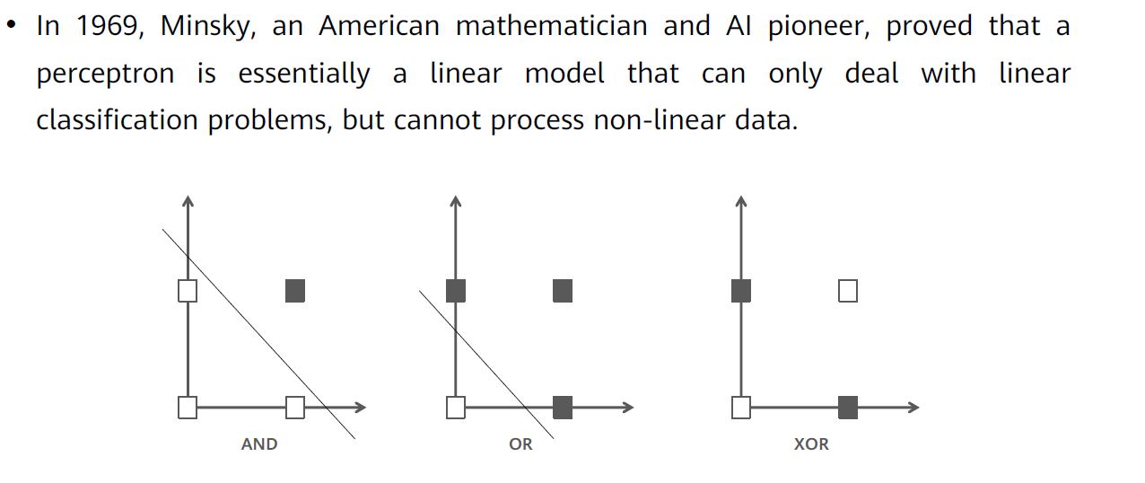
03
XOR Problem

Slide 7
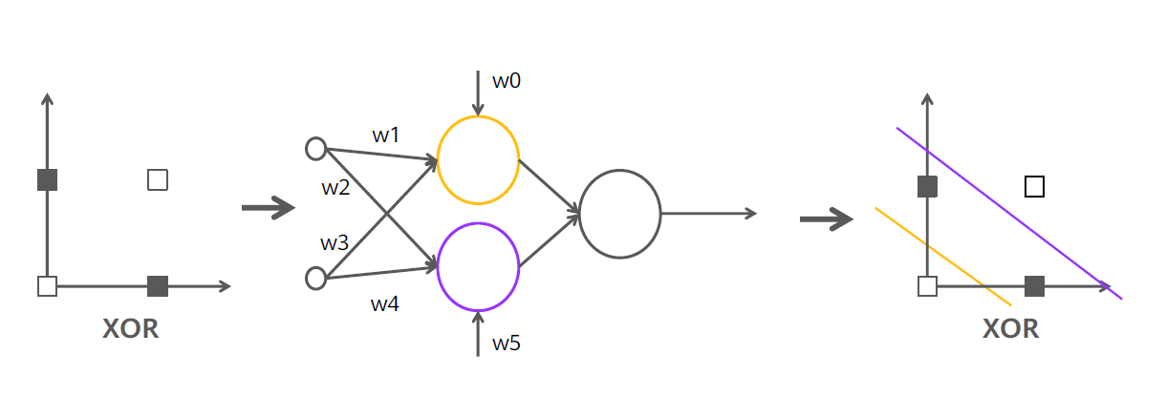
03
Solution of XOR

Slide 8
04
MLP
Neural Network Components:
Layers
• Neurons
• Weights
• Bias
• Activation Functions

Slide 9
04
MLP
Neurons
it is a mathematical operation ; it takes input data multiplied by weights and pass the sum through an activation functions to other neurons

Slide 10
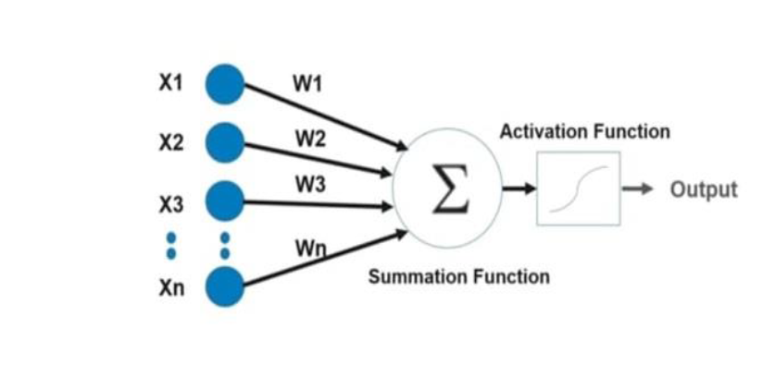
04
MLP
Weights
First they are chosen random at the beginning of training and then it optimized to reduce loss during training.

Slide 11
04
MLP
Bias
Bias is just like an intercept added in a linear equation
output = sum (weights * inputs) + bias
There is only one bias per neuron
There is a vector of bias per layer
Bias is a constant which helps the model in a way that it can fit best for the given data.

Slide 12
04
MLP
is MLP is enough for all problems???
MLP on mnist data experiment
MLP on cifar10 data experiment

Slide 13

Any Question??

Slide 14
Thank You…!
End

